Slide 1

Autonomous Robotic Aerial Vehicle: ARAV Control in Complex Environments
- Akash Sharma

Slide 2
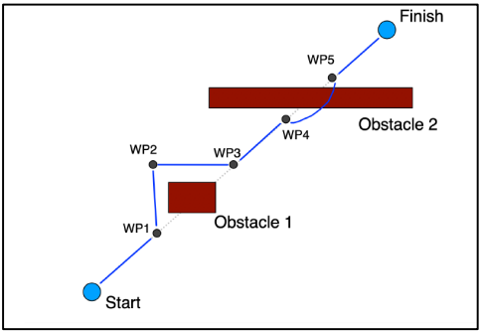
Project Goal
Developing a hybrid vehicle that moves on the ground as well as flies.
Designing it to be autonomous to be able to take decisions while navigating in complex environments with various obstacles.

Slide 3
Project Issues
Master algorithm development
To bring together all the individual algorithms controlling different aspects of the motion of the vehicle.
The vehicle will make decisions based on tradeoff analysis to conserve energy and time.
Module Communication
Can be considered as one aspect of developing the master algorithm where data must be shared between the 2 modules if switching is needed
Weight and PID tuning
These are important issues to be resolved to improve the aerial stability and performance of the vehicle

Slide 4
Main Bibliography
J. Bessa and A. Ceballos, “Autonomous robotic aerial vehicle: S3 project report”, March 2022.
K. Mallabadi and R. Dsouza, “Autonomous robotic aerial vehicle: S3 project report”, March 2022.
Yu, Po-Lung, Yoon-Ro Lee, and Antonie Stam. Multiple-criteria Decision Making: Concepts, Techniques, and Extensions. 1st Ed. 1985.. ed. 1985. Mathematical Concepts and Methods in Science and Engineering; 30. Web.

Slide 5
Technical Progress
The following table shows the current validation status of the various algorithms used.

Slide 6
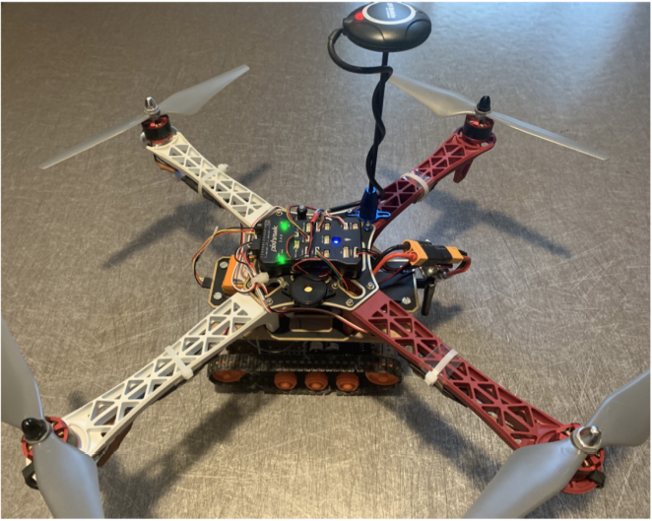
Technical Progress
This is the fully assembled prototype used for validation testing

Slide 7
Timeline
February
Project and objectives understanding
ROS, Pixhawk and Gazebo study
March
Literature review on Decision-making algorithms
April
PID tuning and weight control
Flight test validation
May
June
Developing the baseline DM algorithm
Algorithm simulation
Testing on the vehicle with some use cases
Investigating latency issues
Work Done
Developing an understanding of the project goal and its current state along with several issues that have persisted.
Familiarization with the simulation platforms used for testing as well as a literature review about decision-making algorithms.
Work to be done
PID and weight tuning investigation with flight test validation
Developing the master algorithm in conjunction with simulations and testing use cases.

Slide 8
Thank you for your time

